Slide 1
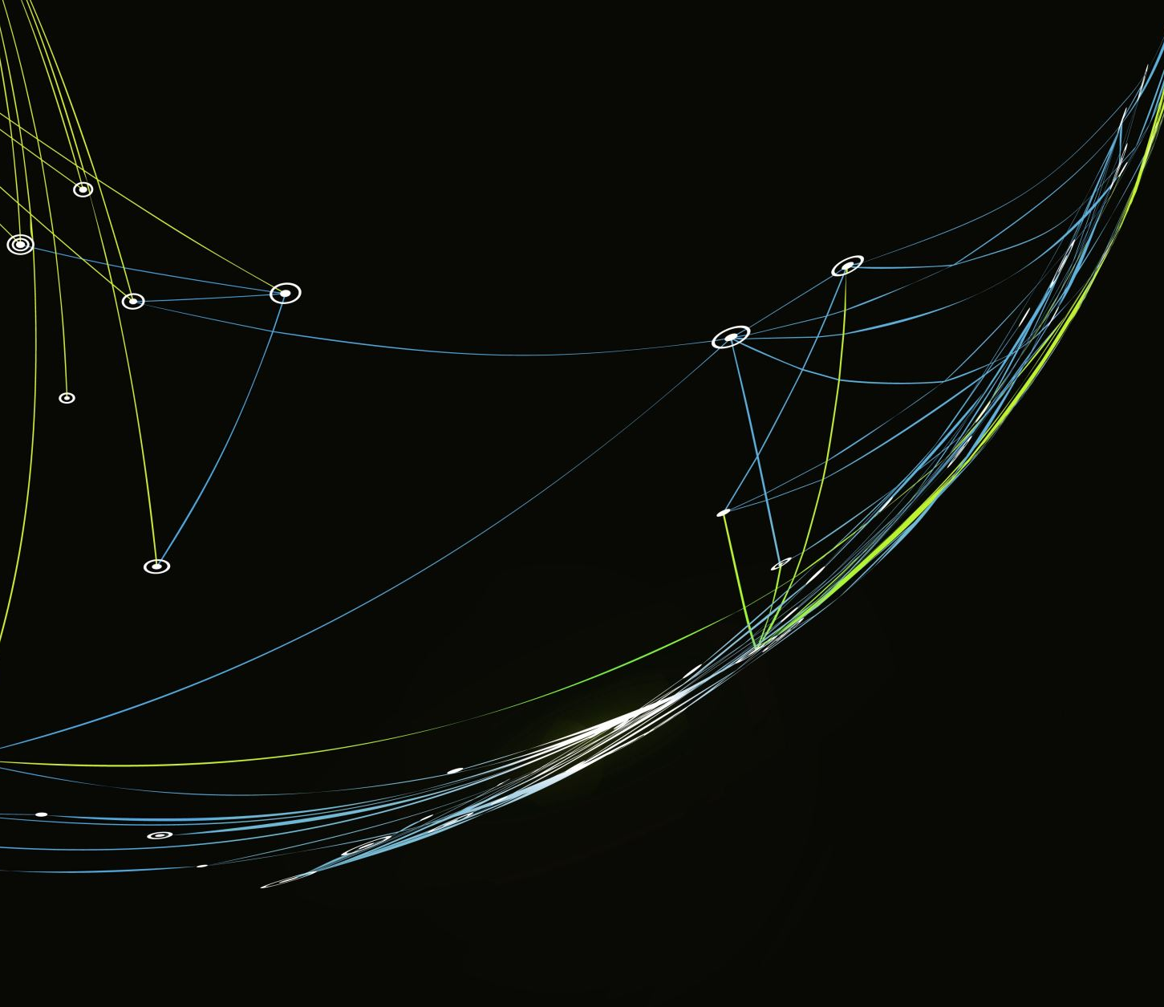
SENTENCE AUTOCOMPLETE SYSTEM

Slide 2
SENTENCE AUTOCOMPLETE SYSTEM
Presented By:
Varshith Reddy Kallem- 11603452
Sahithya Voleti 11644139

Slide 3
Introduction
Long short-term memory (LSTM)
Learning long-term dependencies between words
Feedback connections
Notes:
Long short-term memory (LSTM) networks are very effective at predicting the next words in a sequence, such as with text prediction. LSTM networks are a type of recurrent neural network capable of learning long-term dependencies between words. They have feedback connections that allow them to effectively maintain information about what has been said previously in a sequence. For next word prediction, the LSTM examines the current sequence of words along with context like punctuation and generates a probability distribution over possible next words. It learns to do this by being trained on large amounts of text where it sees the actual next words and updates its weights. During prediction, it suggests the most likely next words based on its training.

Slide 4

Problem statement/Hypothesis
The system takes as input the beginning of a sentence typed by the user. It uses an LSTM model trained on a large text corpus.
The pretrained LSTM model calculates the conditional probability distribution of the next word given the previous words entered so far.(Cruz-Benito et al., 2021)
It returns the top 3 or 5 most probable next words as autocomplete suggestions to the user in real-time.
As the user continues typing, the model updates its prediction of next words based on the new context provided by each additional word.

Slide 5
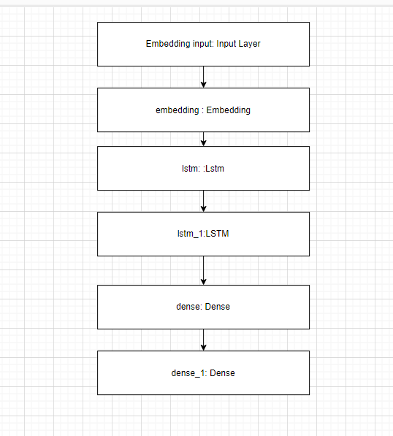
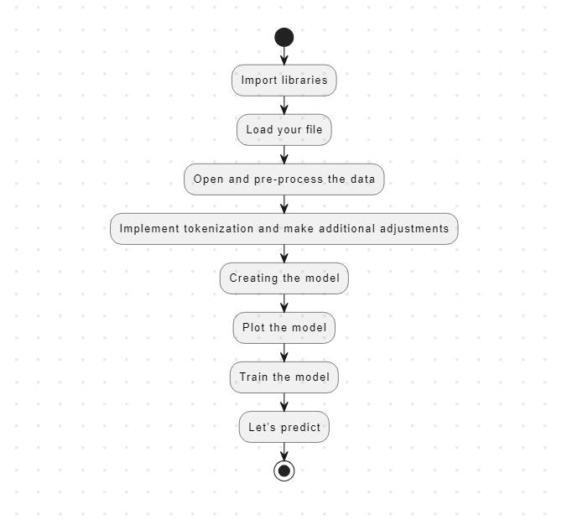
Methodology
Notes:
In the above picture, this is the diagram of models.
Workflow diagram
Tokenization and sequences of word windows
Padding sequences of varying lengths
Embedding layer to convert words to vectors
LSTM layers to capture context
Training on sequences to predict next word
Storing tokenizer and model for future predictions

Slide 6
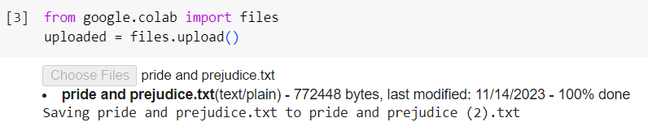
Dataset
Notes:
In the above picture, this is the code for uploading the data set into Google Collab. From this dataset the other process will be done.

Slide 7
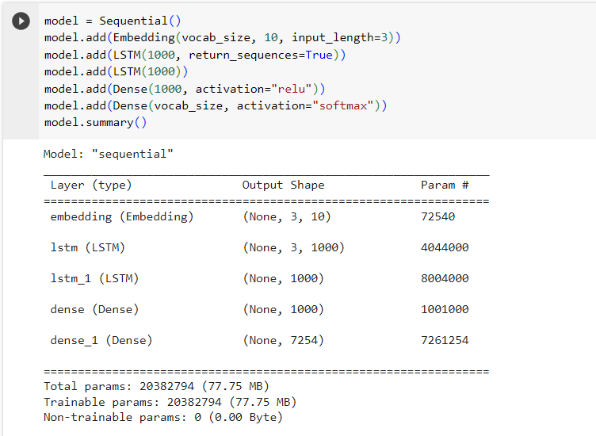
Exploratory data analysis
Notes:
In the above picture, this is the code for creating the model. In this model, there are three-row layers, output shapes, and params. Layers are in this lstm, lstm_1, dense and dense_1.

Slide 8
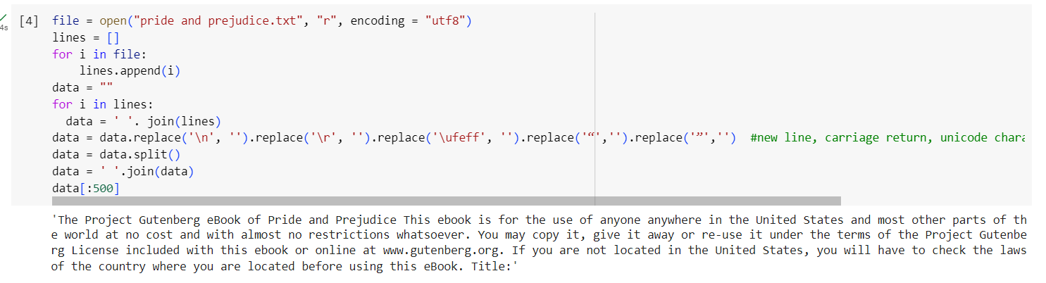
Imported Libraries
Notes:
In the above picture, this is the code for pre-processing the data in this data-cleaning, data splitting, joining data, and removing unnecessary spaces. A critical phase in machine learning is data preprocessing, which converts unprocessed data into a format that can be used to train models. This includes resolving missing values, organizing and cleaning data, and scaling features to a consistent range. To improve model performance, categorical variables can also be encoded and outliers eliminated. By ensuring consistent inputs, data normalization stops certain traits from predominating over others. By addressing class imbalances, balancing datasets improves model learning. Effective data preparation is crucial to the success of machine learning applications since it enhances model efficiency, generalization, and accuracy overall.

Slide 9
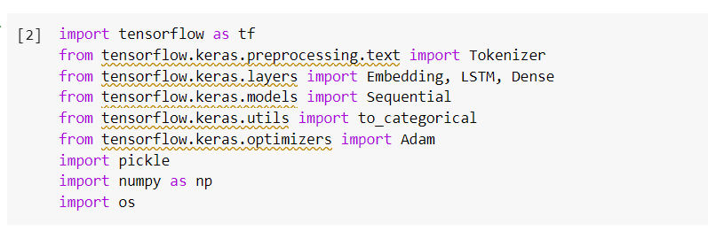
Implementation
Notes:
In the above picture, there are the imported libraries that are needed for this project. The main library is TensorFlow which helps to analyze this project. The Google team created the open-source machine learning framework TensorFlow. It emphasizes scalability and flexibility while making machine learning model development and deployment easier. TensorFlow uses a data flow graph, with nodes standing in for mathematical operations and edges for data flow, to depict computing processes. TensorFlow is a popular tool in both academia and business, with a wide range of uses, including computer vision and natural language processing. Its broad ecosystem and abstraction layers make it easier to create intricate neural network topologies, which makes it a vital resource for artificial intelligence researchers and developers.

Slide 10
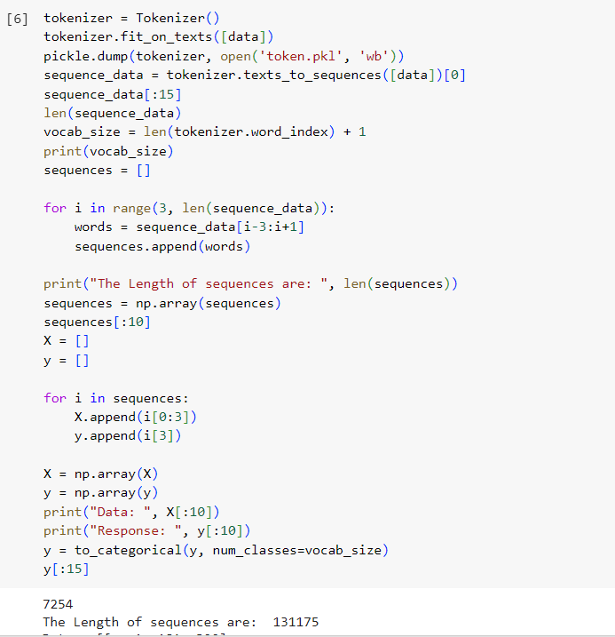
Implement tokenization and make additional adjustments
Notes:
In the above picture, this is the code for implementing tokenization that is done in Google Colab.
Tokenization in Google Colab may be accomplished by utilizing well-known NLP frameworks such as TensorFlow. Tokenizers from these libraries can be used to convert textual data into numerical sequences. (Zhang 2021) To help with future model training, text data may be fitted to and tokenized using TensorFlow's `Tokenizer` class. As an alternative, Hugging Face's Transformers offer pre-trained tokenizers that work with a range of models, increasing productivity. In the Google Colab environment, this procedure is necessary to transform textual data into a format that is appropriate for machine learning models, allowing for efficient analysis and comprehension of natural language patterns.

Slide 11
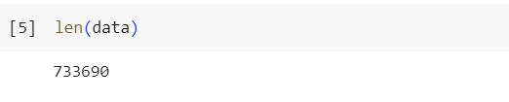
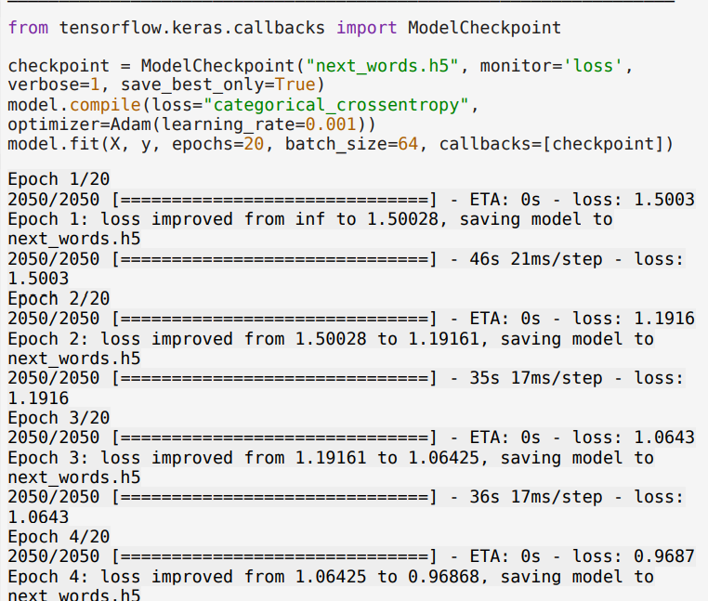
Results
Notes:
In the above picture this is the code for training the model. There are tensor flow libraries imported to the model checkpoint that will help to train the model. A total of 20 epochs to train this model. Every epoch has losses.

Slide 12
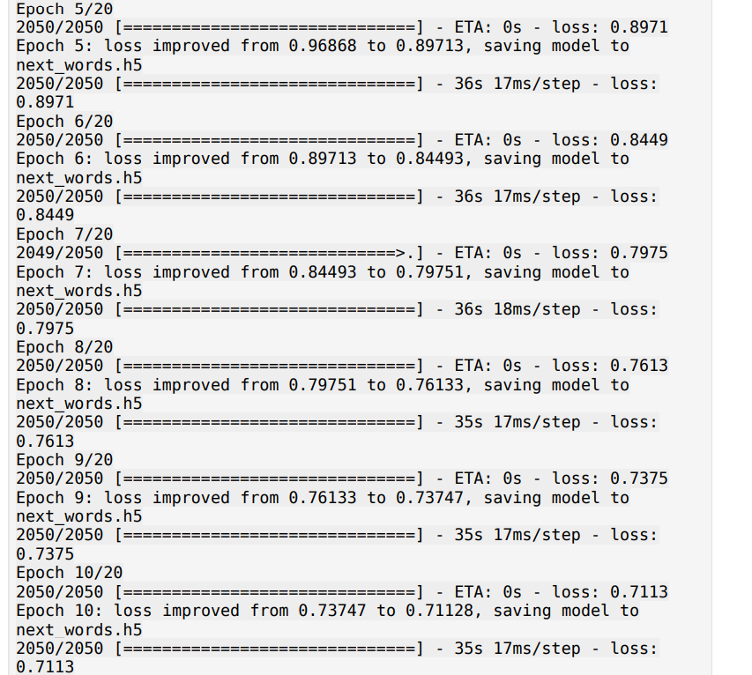
Results

Slide 13
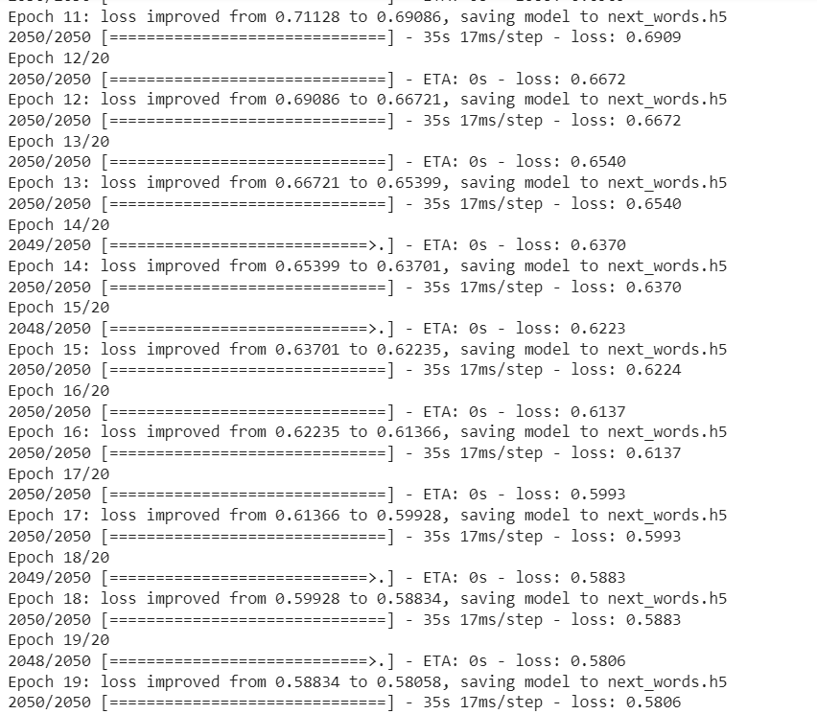
Results

Slide 14
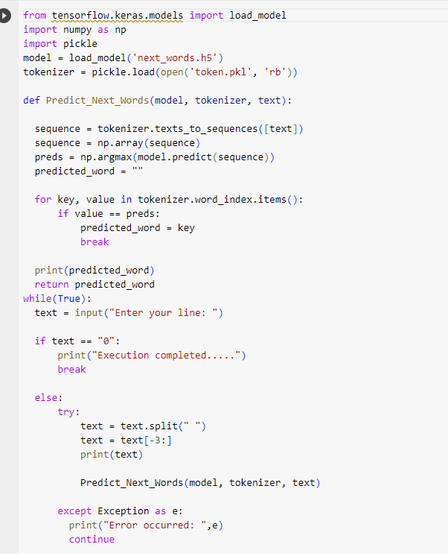
Implementation for snip of result for sentence autocomplete system

Slide 15
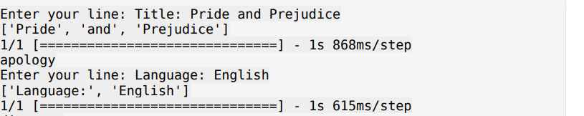
Results

Slide 16
Project Management
Define the scope - Determine the overall goals and limitations of the project. Clearly define what is and isn't included. (Varshith Reddy Kallem-11603452)
Create a schedule - Break the work down into specific tasks and create a timeline projecting start and finish dates for each. Allow for contingencies.(Sahithya Voleti- 11644139)
Manage the budget - Track costs and allocate funding appropriately across each task. Adapt to changes to stay within budget. (Varshith Reddy Kallem-11603452)
Oversee team and responsibilities - Assign team members to specific roles and tasks. Monitor progress, provide support and resolve issues. Ensure accountability and quality of deliverables.(Sahithya Voleti 11644139)

Slide 17
Conclusion
This project developed and tested an LSTM neural network model for sentence autocomplete.
An LSTM was chosen due to its ability to learn long-term dependencies in sequential data like text.
The model was trained on a large text corpus to learn word patterns and combinations. The model was implemented using Python and TensorFlow/Keras libraries for deep learning.
Text data was cleaned and preprocessed, including tokenization, before being fed to the LSTM layers.
The model was trained for 20 epochs to optimize the weights for next word prediction.

Slide 18

Reference
Cruz-Benito, J., Vishwakarma, S., Martin-Fernandez, F. and Faro, I., 2021. Automated source code generation and auto-completion using deep learning: Comparing and discussing current language model-related approaches. AI, 2(1), pp.1-16. https://www.mdpi.com/2673-2688/2/1/1/pdf
Zhang, T., 2021. Smart Compose for Live Chat Agent. https://www.diva-portal.org/smash/get/diva2:1611327/FULLTEXT01.pdf

Slide 19
Presentation link
Presentation Link:
https://drive.google.com/file/d/1WxVirBtiRwKX3Yr1jE_E7ghise3yMaKS/view?usp=drive_link
GitHub link:
https://github.com/orgs/kallem123/teams/group15-nlp/members

Slide 20

Thank You

